Slide 1
Set Up Azure Student Account
CIS 174
Vernon Alatorre

Slide 2
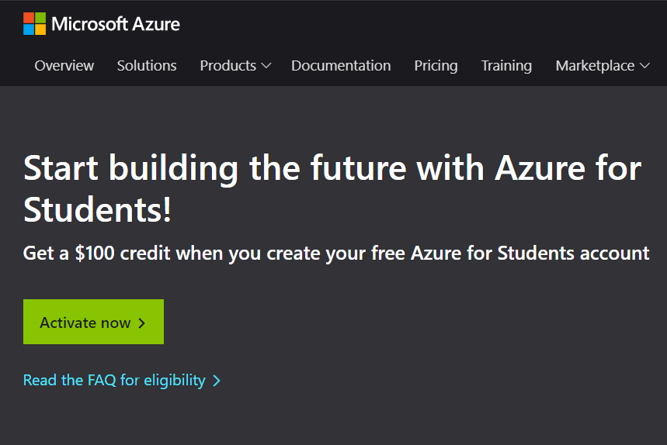
Azure Student Account
Setup a free student account. It make take a few days so do not delay.
https://azure.microsoft.com/en-us/free/students/

Slide 3
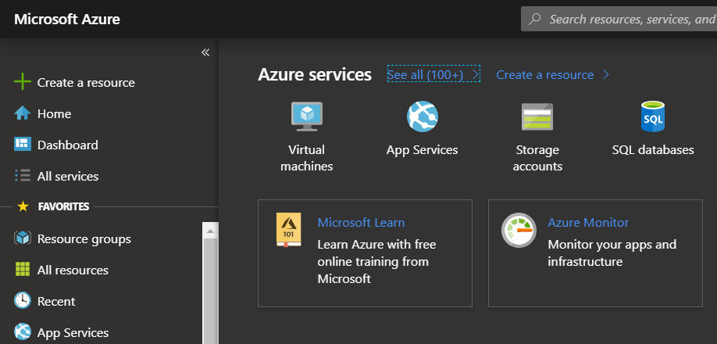
Azure portal
Check out your portal
https://portal.azure.com

Slide 4
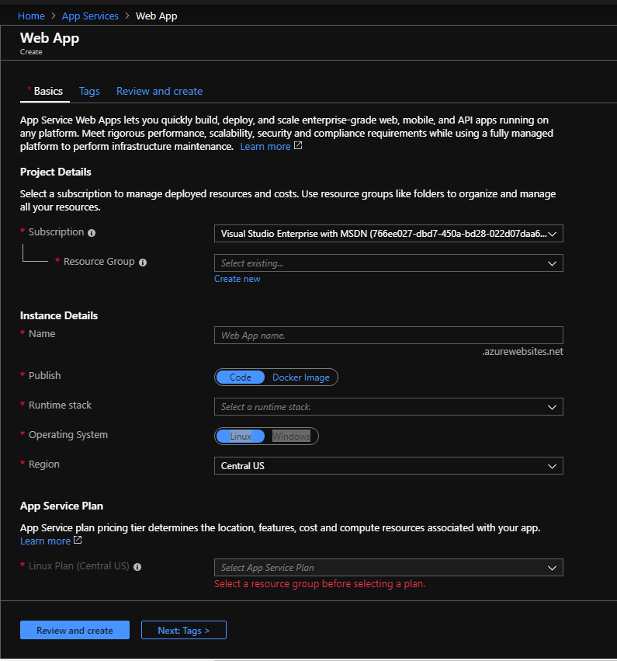
Create a new App Service
Select subscription
Create new resource group
Name your app cis174dmacc login name.
Ex cis174valatorre
Runtime stack = .net core 2.1

Slide 5
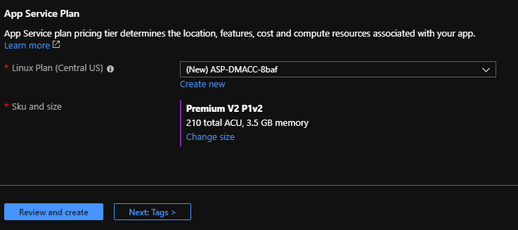
Configure size and submit
Click on change size
Select D-1 Shared ($9 /month)
MUST select D-1 or the free tier or you will end up having to pay towards the end of the course.
Click Review and create
Click Create on the review screen
Wait for it to create

Slide 6
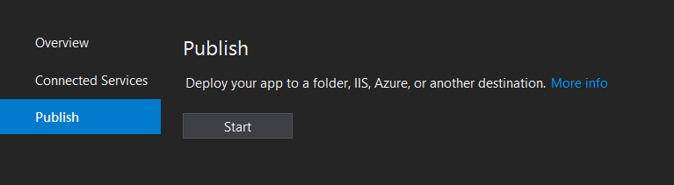
Deploy from visual studio
Create a new project, empty, and set up the WelcomePageMiddleware.
Verify you can run your app locally and see the welcome page.
In the solution explorer right click on the project in Visual Studio and select publish
Under publish hit start:

Slide 7
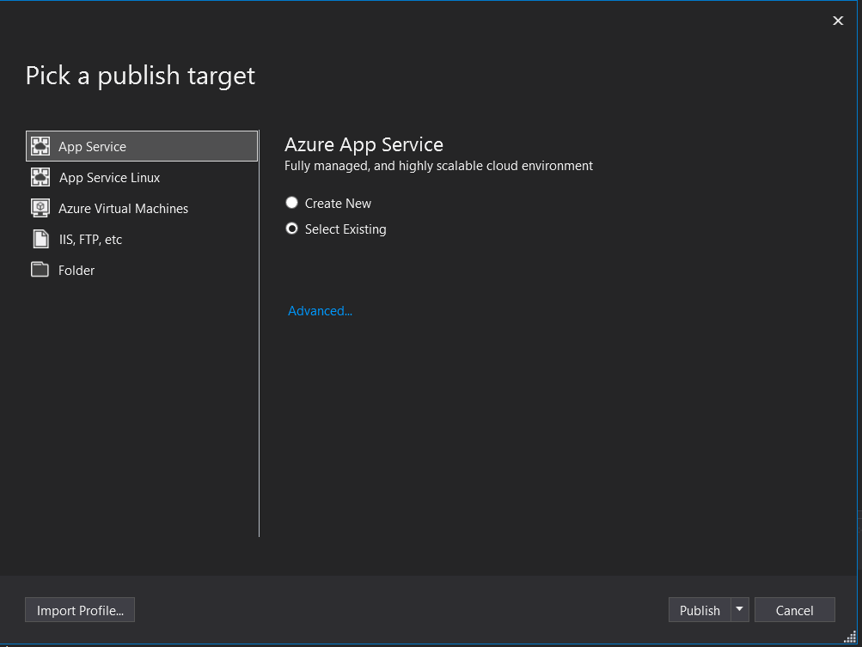
Deploy from Visual Studio (cont.)
Select App Service
Check “Select Existing”
Click Publish

Slide 8
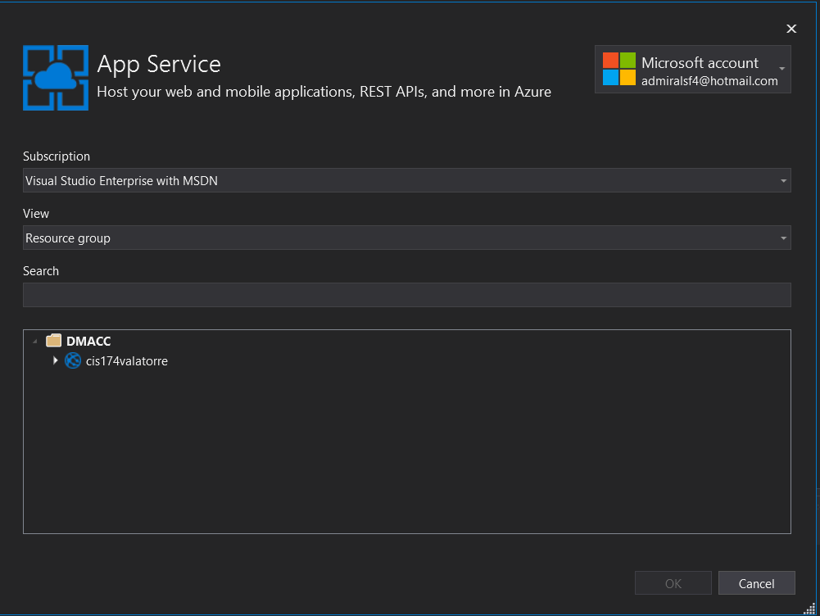
Deploy from Visual Studio (cont.)
You must sign in with your dmacc account
Down at the bottom select the one you just created
For me “cis174valatorre”
Click okay

Slide 9
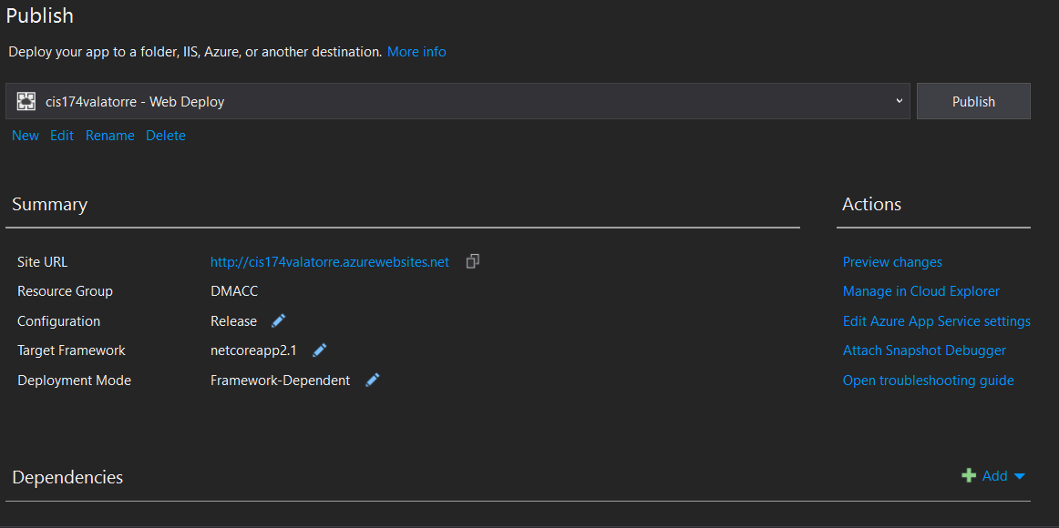
Deploy from Visual Studio (cont.)
This should deploy the app and open a browser tab to it.
If it does not, or when you want to publish again, you just come here and click the publish button.

